Slide 1
Bank Management System Using C++
My self:-
Isneha varshney
B.Tech Computer Science Student.
Jaypee University

Slide 2
Introduction
Basic implementation of a banking system
Performs fundamental banking operations
Uses C++ concepts: structures, functions, logic, loops
The Bank Management System is a simple console-based project in C++.

Slide 3
Objective
Create a simple console-based bank management system project in c++.
Features: Create account, Deposit, Withdraw, View info, PIN security.

Slide 4
Tools & Language Used
Language: C++
Compiler: Code::Blocks
Key Concepts: Structures, Functions, Loops, Conditionals, I/O

Slide 5
Features Implemented
Create a new bank account with account number, name, initial balance, and PIN.
Deposit money with PIN verification.
Withdraw money securely.
Display account information.
Secure PIN-based access for every operation

Slide 6
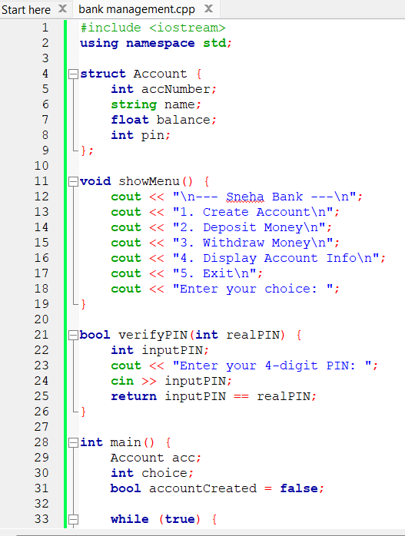
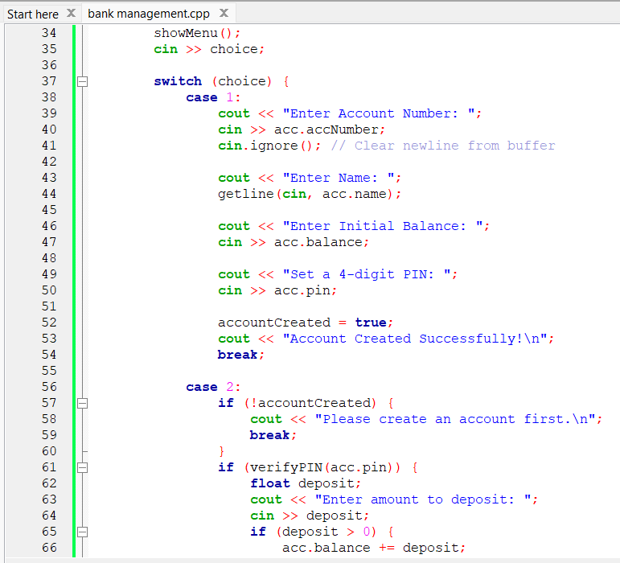
Code Screenshot part-1

Slide 7
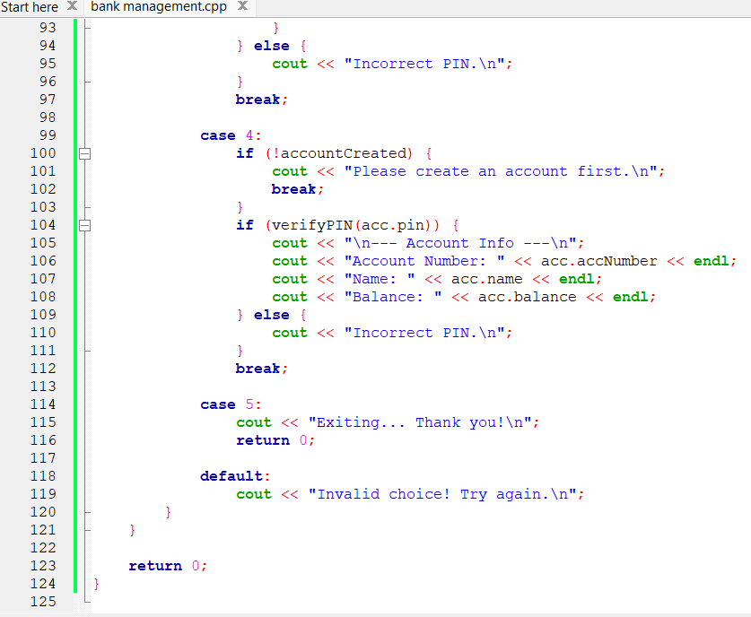
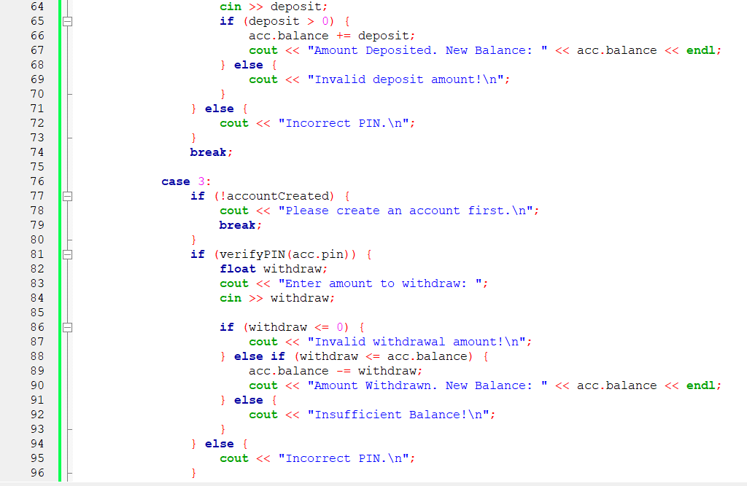
Code screenshot –part 2

Slide 8
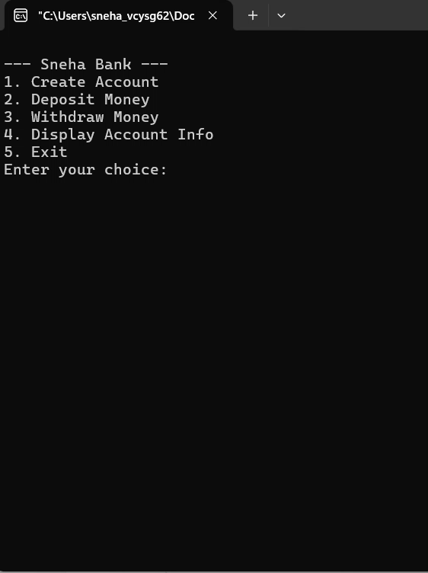
Output is running.

Slide 9
Future Improvements
Support for multiple accounts
PIN change option
Transaction history tracking
Login system with username/password

Slide 10
Conclusion
Learned practical use of C++ basics
Demonstrates structured programming and real-world logic
Strong foundation for future projects

Slide 11
Thankyou everyone

